Slide 1


Slide 2

Mini Project (01CE0609)
Review 1 (08/03/2025)
Disease Prediction using Medical Data
Team ID: 146
Team Member 1: Guy Bruno NDIKUMANA (92200103297)(6TC4)
Team Member 2: Frank Luke MUTENTWA (92200103318)(6TC4)
Guided By
Internal Guide Name: Prof. Pappu Kumar Rai
Department of Computer Engineering, Faculty of Engineering & Technology

Slide 3
Outline
Introduction
Significance of disease Prediction
Impact of timely diagnosis
Healthcare resource optimization
Data Collection
Preprocessing and EDA
Training and Testing the Model
Deploying the Model
Conclusion

Slide 4
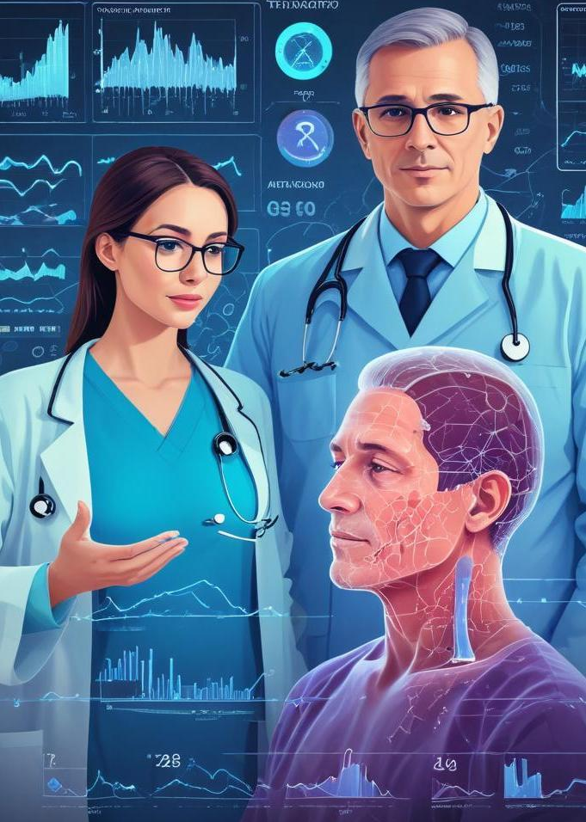
Introduction
Introduction
This presentation explores the significance of disease prediction using medical data, outlining methodologies, impacts, and implementation processes.

Slide 5
01
Importance

Slide 6
Significance of disease prediction
Disease prediction is critical for early intervention, leading to better patient outcomes, reduced healthcare costs, and enhanced quality of life. By leveraging data analytics, healthcare providers can identify at-risk populations, implement preventive strategies, and allocate resources optimally.

Slide 7
Impact of timely diagnosis
Timely diagnosis significantly improves treatment effectiveness. It allows healthcare providers to initiate therapy sooner, minimizing complications and mortality rates. With accurate prediction models, physicians can make informed decisions, tailor treatment plans based on patient-specific risk factors, and enhance overall patient management.

Slide 8

Healthcare resource optimization
Optimizing healthcare resources through disease prediction enhances the efficiency of medical services. By accurately predicting disease outbreaks and patient needs, healthcare systems can allocate resources such as staff, equipment, and finances more effectively. This ensures that high-risk patients receive necessary care while minimizing waste in less critical areas.

Slide 9
02
Model Implementation

Slide 10
Data Collection
Data collection involves gathering relevant medical data from diverse sources including hospitals, laboratories, and public health records. It is crucial to include a wide range of variables such as patient demographics, previous health records, and environmental factors. High-quality data sets provide a solid foundation for building reliable predictive models.
For this model, we have used the dataset called
Disease Prediction Data available already on Kaggle.

Slide 11

Preprocessing and EDA
Preprocessing is essential for preparing data for analysis, involving steps such as cleaning, normalization, and transformation. Exploratory Data Analysis (EDA) allows researchers to understand data distributions and identify patterns or anomalies before modeling. This step enhances the model's accuracy by ensuring that the data is in a suitable format.

Slide 12
Training and Testing the Model
Model training involves using the processed dataset to teach the machine learning algorithm how to make predictions. It is followed by model testing, where the model is evaluated against unseen data to assess performance. Metrics such as accuracy, precision, and recall are commonly used to determine the model's effectiveness in disease prediction.
We have used a non exhaustive list of algorithms such as: Random Forest Classifier, Decision Tree and Gaussian Nave-Bayes Algorithm

Slide 13
Deploying the Model
Deploying the Model would allow users of the Model to interact with it seamlessly allowing the availability of our algorithm and model. To simplify this, we have created a minimal Flask Python Backend Web Server to which we have created REST API endpoints. On client visualization, we have created a website with NextJS that would visualize and predict the diseases while interacting with our backend server.

Slide 14
Conclusion
In conclusion, disease prediction using medical data is vital for improving public health outcomes. By leveraging advanced modeling techniques and optimizing resource allocation, healthcare providers can significantly enhance diagnosis and treatment efficacy. Adopting these methods leads to a proactive approach in managing diseases and ultimately saving lives.

Slide 15


